Slide 1
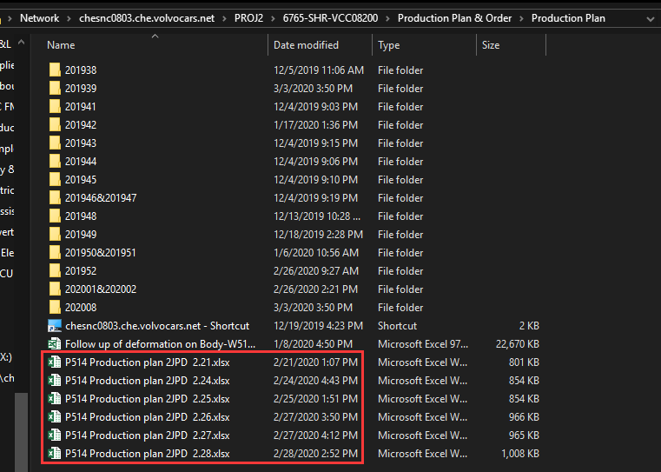
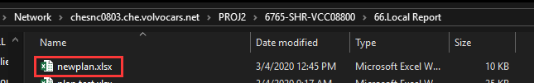
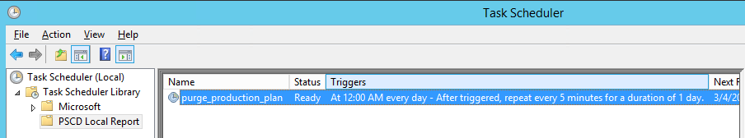
Build an automatic process to get required production plan figures
Quick guide
The original production plan located at MP&L public sharedisk, which named: “P514 Production plan *”
After data purge, the result file put under IT public sharedisk named “newplan.xlsx”, so that powerbi can directly get what it want
There is a windows task scheduled every 5 minutes on chepsvw3004 to run the program: D:\PSCD Local Report\Purge production plan\purge_production_plan.exe to refresh the latest production plan
\\chesnc0803.che.volvocars.net\PROJ2\6765-SHR-VCC08200\Production Plan & Order\Production Plan
\\chesnc0803.che.volvocars.net\PROJ2\6765-SHR-VCC08800\66.Local Report

Slide 2
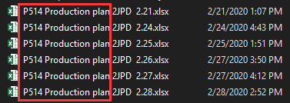
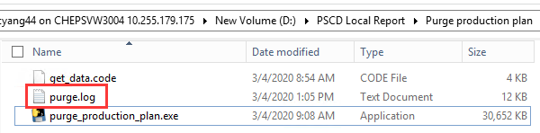
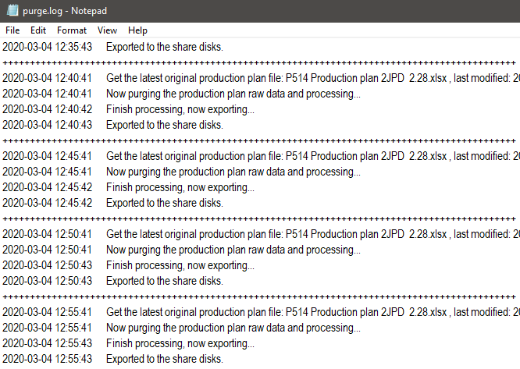
Requirements and Notices
Guaranteed by MP&L users: the original production plan should be put on the same folder and keep the same format, and should follow the same naming rule: start with “P514 Production plan”(Case sensitive). Like the left picture shows.
Guaranteed by IT: the windows task should run normally. Because it use ID authentication to access to the publish share disk, so if $account’s password has been updated, also need to update in the windows task.
Notice: there is a log put under the same folder of program, according to the log we can have a quick judgement if the program is running normally.

Slide 3

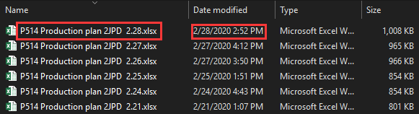
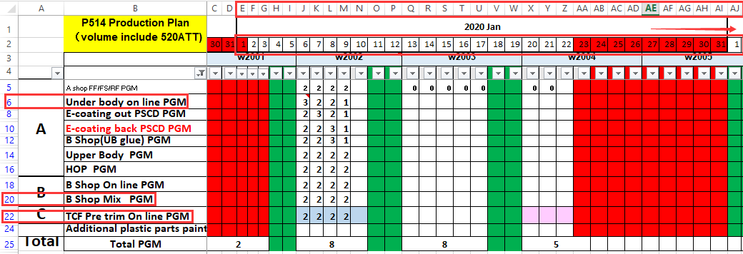
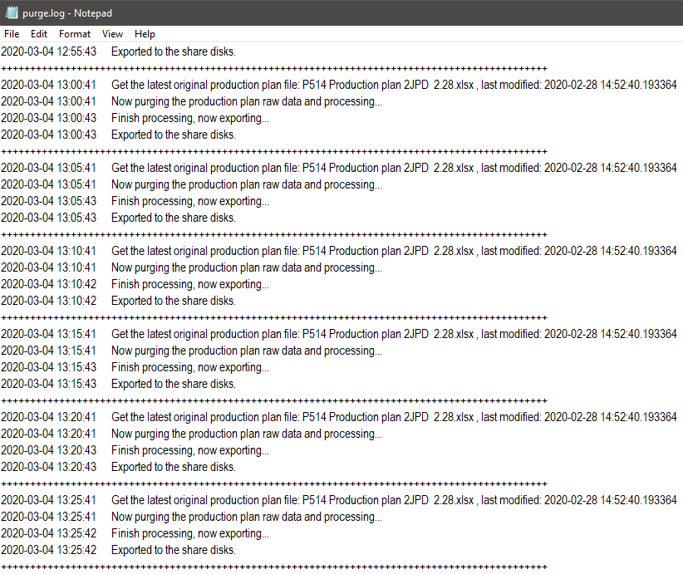
Algorithm
The code was put under the same folder of program, named: get_data.code, following the below steps:
Find the newest production plan: list all the files whose name started with “P514 Production plan”, get their last modified date, then find which is the newest production plan original file.
Read the first sheet of the excel, and add to log which file we choose and it’s last modified date.
Data purge: we just need 3 kind of data: A shop on line PGM, B shop mix PGM, C shop pretrim on line PGM which located at the 6/20/22 rows, and the 2020/01/01 – 2020/12/31 date located at 5~370 columns, get these data. (in python array, the rows are 4,18,20 and the columns are 4~369)
Add title and export to share disk, record the result in purge.log file.

